Slide 1
Input-Output Organization
Peripheral devices
Input-output interface
Asynchronous data transfer
Modes of transfer
Priority interrupt
Direct Memory Access
Privileged and Non-Privileged Instructions

Slide 2
Need for I/O Interface
Input–output interface provides a method for transferring information between internal storage and external I/O devices.
Peripherals connected to a computer need special communication links for interfacing them with the CPU and each peripheral.
The purpose of the communication link is to resolve the differences that exist between the central computer and each peripheral.
The major differences are:
  Peripherals are electromechanical and electromagnetic devices and their operation is different from the operation of CPU and memory, which are electronic devices. Therefore, a conversion of signal values may be required.
  The data transfer rate of peripherals is usually slower than the transfer rate of CPU, and consequently, a synchronization mechanism may be needed.
  Data codes and formats in peripherals differ from the word format in the CPU and memory.
  The operating modes of peripherals are different from each other and each must be controlled so as not to disturb the operation of other peripherals connected to the CPU.

Slide 3
I/O Interface
To resolve these differences, computer systems include special hardware components between the CPU and peripherals to supervise and synchronize all input and output transfers.
These components are called interface units because they interface between the processor bus and the peripheral device.
To attach an input–output device to CPU and input–output interface, circuit is placed between the device and the system bus.
The main function of input–output interface circuit are data conversion, synchronization and device selection.

Slide 4
I/O Bus and Interface Modules
The I/O bus consists of data lines, address lines, and control lines.
Each peripheral device has associated with it an interface unit.
Each interface decodes the address and control received from the I/O bus, interprets them for the peripheral, and provides signals for the peripheral controller.
It also synchronizes the data flow and supervises the transfer between peripheral and processor.
Each peripheral has its own controller that operates the particular electromechanical device.
To communicate with a particular device, the processor places a device address on the address lines.
Each interface attached to the I/O bus contains an address decoder that monitors the address lines.
When the interface detects its own address, it activates the path between the bus lines and the device that it controls.
All other peripherals are disabled by their interface.

Slide 5
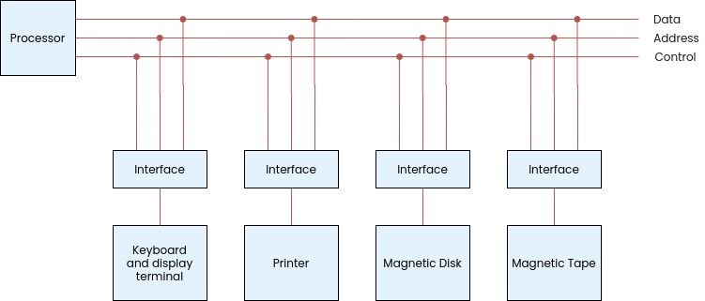
I/O Bus and Interface Modules

Slide 6
I/O Command
At the same time that the address is made available in the address lines, the processor provides a function code in the control lines.
The function code (I/O command) is an instruction that is executed in the interface and its attached peripheral unit.
There are four types of commands that an interface may receive.
  Control command - issued to activate the peripheral and to inform it what to do.
  Status command - used to test various status conditions in the interface and peripheral.
  Data output command - causes the interface to respond by transferring data from the bus into one of its registers.
  Data input command allows the interface to receive a data item from the peripheral which is placed in its buffer register. The processor checks if data are available by means of a status command and then issues a data input command. The interface places the data on the data lines, where they are accepted by the processor.

Slide 7
I/O versus Memory Bus
In addition to communicating with I/O, the processor must communicate with the memory unit.
Like the I/O bus, the memory bus contains data, address, and read/write control lines.
There are three ways that computer buses can be used to communicate with memory and I/O:
  Use two separate buses, one for memory and the other for I/O - (IOP)
  Use one common bus for both memory and I/O but have separate control lines for each - (Isolated I/O)
  Use one common bus for memory and I/O with common control lines - (Memory Mapped I/O)

Slide 8
Isolated I/O
Isolated I/O uses one common bus to transfer information between memory or I/O and the CPU.
The distinction between a memory transfer and I/O transfer is made through separate read and write lines.
The I/O read and I/O write control lines are enabled during an I/O transfer. The memory read and memory write control lines are enabled during a memory transfer.
This configuration isolates all I/O interface addresses from the addresses assigned to memory and is referred to as the isolated I/O method for assigning addresses in a common bus.
The isolated I/O method isolates memory and I/O addresses so that memory address values are not affected by interface address assignment since each has its own address space

Slide 9
Memory Mapped I/O
Memory mapped I/O use the same address space for both memory and I/O.
It employ only one set of read and write signals and do not distinguish between memory and I/O addresses.
The computer treats an interface register as being part of the memory system.
The assigned addresses for interface registers cannot be used for memory words, which reduces the memory address range available.
There are no specific input or output instructions.
The CPU can manipulate I/O data residing in interface registers with the same instructions that are used to manipulate memory words.
The advantage is that the load and store instructions used for reading and writing from memory can be used to input and output data from I/O registers.

Slide 10
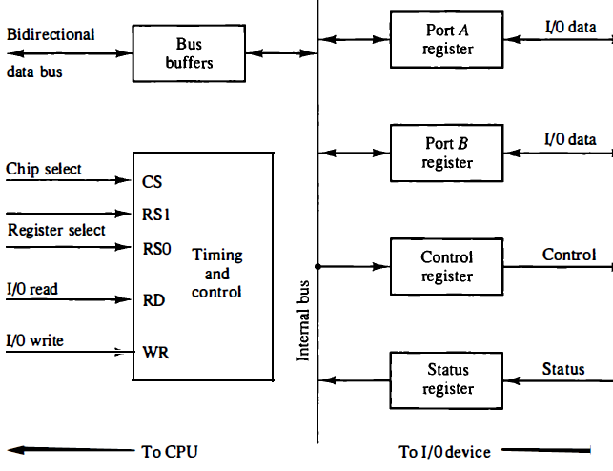
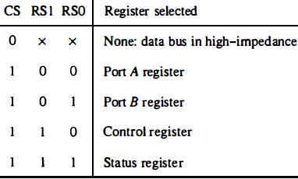
Example of I/O INTERFACE UNIT
I/O interface consists of - 2 data registers (ports), Control register, Status register, Bus buffers, Timing and control circuits
Interface communicates with CPU through data bus
CS and RS-0,1 inputs determine the ADDRESS assigned to the interface
I/O read and write - Control lines to specify input or output operation
Four registers communicate directly with I/O device attached to the interface
ADDRESS BUS selects interface unit using RS0, RS1, CS
When a interface unit is selected by the address bus,
  CS is enabled, RS1 and RS0 select one of the four registers (RS1, RS0 are connected to the two least significant lines of address bus).
  Content of selected register is transferred to CPU via data bus when I/O READ signal is enabled.
  CPU transfers binary information to selected register via the data bus when I/O WRITE input is enabled.

Slide 11
Data Transfer
Synchronous Data Transfer
Internal operations are synchronized by means of clock pulses.
All data transfers among internal registers occur simultaneously during the occurrence of a clock pulse.
The registers in the interface share a common clock with the CPU registers.
Asynchronous Data Transfer
It requires that control signals be transmitted between the communicating units to indicate the time at which data is being transmitted.
Internal timing of each unit (interface and CPU) is independent.
Each unit uses its own private clock for internal registers.

Slide 12
Strobe Control and Handshaking
Asynchronous data transfer between two independent units requires that control signals be transmitted between the communicating units to indicate the time at which data is being transmitted.
One way of achieving this is by means of a strobe pulse supplied by one of the units to indicate to the other unit when the transfer has to occur.
Another method commonly used is to accompany each data item being transferred with a control signal that indicates the presence of data in the bus.
The unit receiving the data item responds with another control signal to acknowledge receipt of the data.
This type of agreement between two independent units is referred to as handshaking.
The strobe pulse method and the handshaking method of asynchronous data transfer are not restricted to I/O transfers.

Slide 13
Strobe Control
It employs a single control line to time each transfer.
The strobe may be activated by either source or destination unit.
The data bus carries binary information from source to the destination
The strobe is a single line that informs the destination unit when a valid data word is available in the bus.

Slide 14
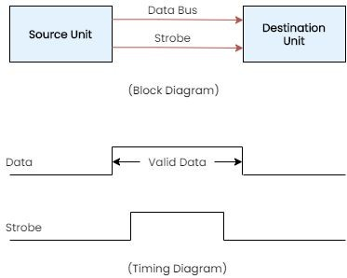
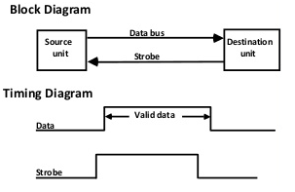
Source and Destination initiated strobe for data transfer
  The source unit first places the data on the data bus.
  After brief delay, to ensure that data settle to a steady state value, source activates strobe pulse.
  The information on data bus and the strobe signal remain in active state for sufficient time period to allow the destination to receive data.
  The source removes data from the bus period after it disables its strobe pulse.
  The destination unit activates the strobe pulse, informing the source to provide the data.
  The source unit responds by placing the requested binary information on the data bus.
  The data must be valid and remain in the bus long enough for the destination unit to accept it.
  The destination unit then disables the strobe.
  The source removes the data from the bus after a predetermined time interval.

Slide 15
Handshaking
The disadvantage of the strobe method
The source unit that initiates the transfer has no way of knowing whether the destination unit has actually received the data item that was placed in the bus.
A destination unit that initiates the transfer has no way of knowing whether the source unit has actually placed the data on the bus.
Two-wire control
The handshake method introduced a second control signal that provides a reply to the unit that initiates the transfer.
One control line is in the same direction as the data flow in the bus from the source to the destination.
It is used by the source to inform the destination whether there is valid data in the bus.
The other control line is in the other direction from the destination to source.
It is used by the destination to inform the source whether it can accept data.
The sequence of control during the transfer depends on the unit that initiates the transfer.
This provides a high degree of flexibility and reliability because the successful completion of a data transfer relies on active participation by both units.
If one unit is faulty, the data transfer will not be completed.(Detected by a time-out mechanism)

Slide 16
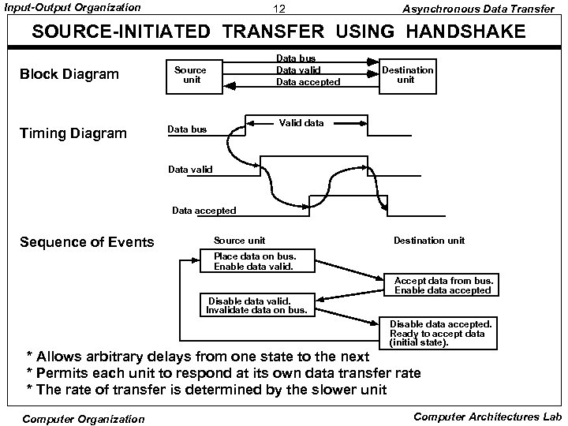
Source-initiated transfer using handshaking
The two handshaking lines are data valid(source unit) and data accepted (destination unit).
The source unit initiates the transfer by placing the data on the bus and enabling its data valid signal.
The data accepted signal is activated by the destination unit after it accepts the data from the bus.
The source unit then disables its data valid signal, which invalidates the data on the bus.
The destination unit then disables its data accepted signal and the system goes into its initial state.
The source does not send the next data item until the destination unit shows its readiness to accept new data by disabling its data accepted signal.
This scheme allows delays from one state to the next and permits each unit to respond at its own data transfer rate.

Slide 17
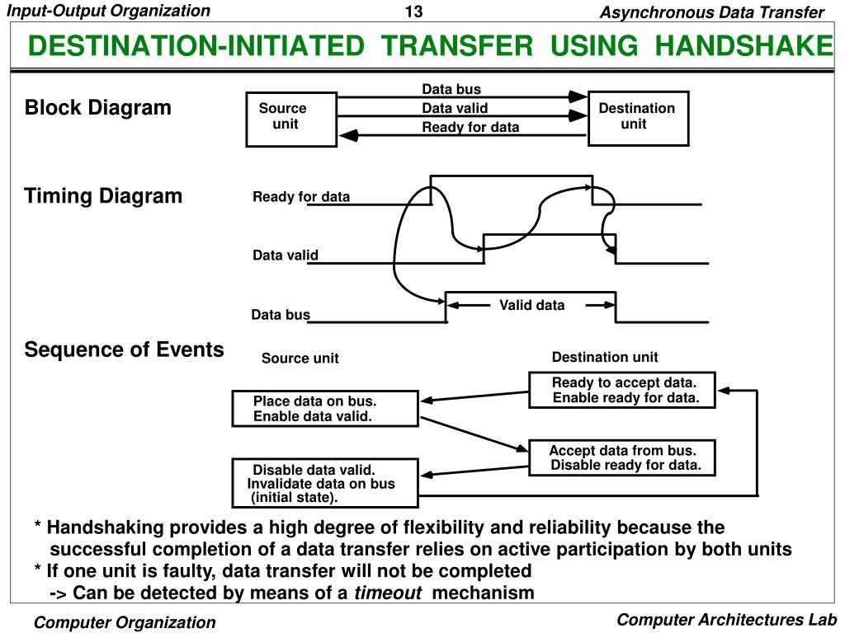
Destination-initiated transfer using handshaking
The source unit in this case does not place data on the bus until it receives the ready for data signal from the destination unit.
From there on, the handshaking procedure follows the same pattern as in the source-initiated case.
The sequence of events in both cases would be identical if we consider the ready for data signal as the complement of data accepted.
The only difference between the source-initiated and the destination-initiated transfer is in their choice of initial state.

Slide 18
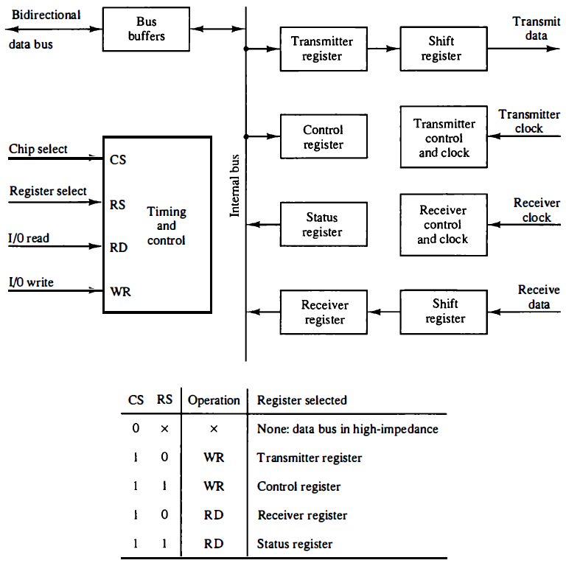
Asynchronous Communication Interface
Transmitter Register : accepts a data byte(from CPU) through the data bus. Transferred to a shift register for serial transmission
Receiver Register: receives serial information into shift register. Complete data byte is sent to receiver register
Status Register Bits : Used for I/O flags (Tx reg. is Empty? / Rx Reg. is Full?) and for recording errors
Control Register Bits : Define baud rate, no. of bits in each character, whether to generate and check parity, and no. of stop bits
Interface is said to be double buffered because a new character can be loaded as soon as the previous one starts transmission
Interface checks three possible errors during transmission
  Parity Error - number of 1's in the received data is not the correct parity
  Framing Error - occurs if right no. of stop bits is not detected at the end of the received character
  Overrun Error - occurs if CPU does not read the character from receiver register before next one becomes available in the shift register and results in loss of characters

Slide 19
First-In First-Out (FIFO) Buffer
It Input data and output data at two DIFFERENT RATES
Output data are always in the SAME ORDER in which the data entered the buffer
FIFO buffer can be useful in applications when data are transferred ASYNCHRONOUSLY
Logic Diagram of a typical 4 x 4 FIFO buffer is shown in below Fig.
It consists of
  Four 4-bit registers RI, I = 1, 2, 3, 4
  Control Register with Flip-Flops Fi, i = 1, 2, 3, 4, one for each register
FIFO can store Four Words of Four Bits each
A Flip-flop
  Fi = 1 indicates that a 4-bit data word is stored in the corresponding register Ri
  Fi = 0 indicates that the corresponding register does NOT contain valid data
If Fi = 1 & Fi+1 = 0 (F’i+1 = 1 )
  a Clock is generated causing register R(I + 1) to accept data from RI
  Same Clock transition sets Fi+1 = 1 and resets Fi = 0
  This causes the control flag to move one position to the right together with the data

Slide 20
  Data in registers move as long as there are empty locations. It stops at the last register R4
  Master Clear is used to initialize all control register flip-flops to 0
When F1=0 (reset)
  indicate register R1 is empty and Input Ready Signal is enabled
  If clock is enabled through INSERT control line, Data is loaded in R1
  Same Clock sets F1=1 which disables the input ready control (indicating that the FIFO is now busy and unable to accept more data)
Ripple-through Process begins provided that R2 is empty
  Data in R1 are transferred into R2 and F1 is cleared
  This enables the INPUT READY LINE
  then inputs are now available for another data word
R1
R2
R3
R4
Data
4-bit
4-bit
4-bit
4-bit
Data
input
register
register
register
register
output
Clock
Clock
Clock
Clock
Insert
S
F
S
F
F
S
S
F
F
S
1
2
3
S
F
4
Output
F'
F'
F'
ready
F
F'
R
R
R
F'
R
R
1
2
3
R
4
Input ready
Delete
Master clear
Fig: Circuit diagram of 4 X 4 FIFO buffer

Slide 21
If FIFO is Full, F1 remains set and INPUT READY LINE is Disabled
Control lines INPUT READY and INSERT constitute (part of) a Destination - Initiated pair of Handshake Lines
When last control flip-flop F4 = 1,
  OUTPUT READY control line is enabled
  indicates that there are valid data in R4
  DESTINATION UNIT accepts data form R4 then enables the DELETE control signal
DELETE control signal resets F4=0
  Disables OUTPUT READY means data on the output are no longer valid
After the DELETE signal = 0, R3 data move to R4
If the FIFO is EMPTY, No data in R3 & F4 = 0
Control lines OUTPUT READY and DELETE constitute a Source -Initiated pair of Handshake Lines

Slide 22
Modes Of Transfer
Data transfer between the central computer and I/O devices may be handled in a variety of modes.
Data transfer to and from peripherals may be handled in one of the three possible modes:
  Programmed I/O
  Interrupt-initiated I/O
  Direct memory access (DMA)

Slide 23
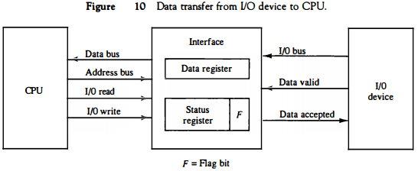
Programmed I/O
Programmed I/O operations are the result of I/O instructions(program) written in the computer program.
Each data item transfer is initiated by an instruction in the program.
Transferring data under program control requires constant monitoring of the peripheral by the CPU.
Once a data transfer is initiated, the CPU is required to monitor the interface to see when a transfer can again be made.
Disadvantage : CPU stays in the program loop until the I/O unit indicates that it is ready for data transfer. This is a time-consuming process since it keeps the processor busy needlessly.
Fig. Data transfer from I/O device to CPU

Slide 24
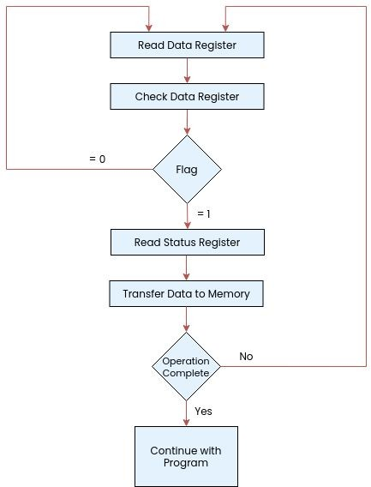
  Device places byte in I/O BUS and enables its DATA VALID line
  Interface accepts the byte into its data register and enables the DATA ACCEPTED line
  Interface sets “flag” (F) bit in the status register
  Device can now disable the data valid line
  Device will NOT transfer another byte until the data accepted line is disabled by the interface.
  This is according to the handshaking procedure
A PROGRAM is written for the computer to check the flag in the status register and to determine if a byte has been placed in the data register by the I/O device
This is done by reading the status register into a CPU register and checking the value of the flag bit (F)
If F=1, the CPU reads the data from data register. Flag bit is then cleared to 0 by either the CPU or the interface
Once F=0, interface disables the data accepted line and device can then transfer the next data byte
Fig. Flowchart for CPU program to input data

Slide 25
Interrupt-Initiated I/O
An alternative to the CPU constantly monitoring the flag is to let the interface inform the computer when it is ready to transfer data. This mode of transfer uses the Interrupt facility.
CPU does not check the flag while executing a program. However, when flag is set, it is momentarily interrupted from proceeding with current program and is informed of the fact that the flag has been set.
CPU then deviates from what it is doing to take care of the input/output transfer.
After the transfer is completed, CPU returns to previous program to continue what it was doing before interrupt.
The CPU responds to the interrupt signal by storing the return address from PC into stack and then control branches to a service routine that processes the required I/O transfer.
There are two methods for getting the branch address.
  Non-Vectored Interrupt: the branch address is assigned to a FIXED LOCATION in memory.
  Vectored Interrupt: the SOURCE (that interrupts) SUPPLIES the branch information to the computer. This information is called the INTERRUPT VECTOR. It is First address of the I/O service routine.

Slide 26
Priority Interrupt
In a typical application, with multiple I/O devices attached to CPU, each device originates an interrupt request.
The Interrupt system has to first identify the source of interrupt and also decide which device to service first.
Priority interrupt - system that establishes a priority over various sources to determine which condition is to be serviced first when two or more requests arrive simultaneously.
It also determines which conditions are permitted to interrupt the CPU while another interrupt is being serviced.
Devices with high speed transfers such as magnetic disks are given high priority, and slow devices such as keyboards receive low priority.
When two devices interrupt CPU at the same time, CPU services the device with the higher priority first.
Methods:
Software – Polling
Hardware - Daisy chaining, Parallel Priority.

Slide 27
Polling
Polling identifies the highest-priority source by software means.
In this method, there is one common branch address for all interrupts.
The program that takes care of interrupts begins at the branch address and polls the interrupt sources in sequence.
The order in which they are tested determines the priority of each interrupt.
The highest priority source is tested first, and if its interrupt signal is ON, control branches to a service routine for this source else next-lower-priority source is tested, and so on.
Disadvantage: If there are many interrupts, the time required to poll them can exceed the time to service the I/O device. To avoid this a hardware priority-interrupt unit can be used to speed up the operation.
A hardware priority-interrupt unit accepts interrupt requests from many sources, determines which of the incoming requests has the highest priority, and issues an interrupt request to the computer based on this determination.
To speed up the operation, each interrupt source has its own interrupt vector to access its own service routine directly. Thus, no polling is required.

Slide 28
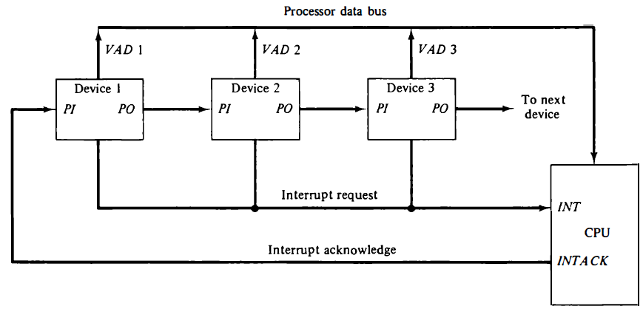
Daisy Chaining
The hardware priority function can be established by either a serial or a parallel connection of interrupt lines.
The serial connection is also known as the daisy chaining method.
It consists of a serial connection of all devices that request an interrupt.
The device with the highest priority is placed in the first position, followed by lower-priority devices up to the device with the lowest priority, which is placed last in the chain.

Slide 29
The interrupt request line(INT) is common to all devices and forms a wired logic connection.
If any device has its interrupt signal in low state, the interrupt line goes to the low state and enables the interrupt input in CPU.
When no interrupts are pending, interrupt line stays in high state and no interrupts are recognized by the CPU.
The CPU responds to an interrupt request by enabling the interrupt acknowledge line(INT ACK).
This signal is received by device 1 at its PI (priority in) input.
The acknowledge signal passes on to the next device through the PO (priority out) output only if device 1 is not requesting an interrupt.
If device 1 has a pending interrupt, it blocks the acknowledge signal from the next device by placing a 0 in the PO output.
It then proceeds to insert its own interrupt vector address (VAD) into the data bus for the CPU to use during the interrupt cycle.
A device with a 0 in its PI input generates a 0 in its PO output to inform the next-lower-priority device that the acknowledge signal has been blocked.
A device that is requesting an interrupt and has a 1 in its PI input will intercept the acknowledge signal by placing a 0 in its PO output.
If the device does not have pending interrupts, it transmits the acknowledge signal to the next device.

Slide 30
Parallel Priority Interrupt
This method uses a register whose bits are set SEPARATELY by the interrupt signal from each device.
Priority logic for a system of four interrupt sources is shown in Fig.
INTERRUPT REGISTER : individual bits are set by external conditions and cleared by PROGRAM instructions
  Priority order High to Low → magnetic disk (high-speed device), printer, character reader, keyboard
Interrupt register
Bus
Buffer
MASK REGISTER has the same number of bits as the interrupt register.
Interrupt bit and its corresponding mask bit are applied to an AND gate to produce the four inputs to a PRIORITY ENCODER.
So, an interrupt is recognized only if its corresponding MASK BIT is set to 1 by the program.
Priority Encoder generates TWO BITS of the VECTOR ADDRESS (x, y), which is transferred to CPU.
Disk
0
I
0
y
Printer
1
I
x
1
Priority
0
Reader
2
I
encoder
2
0
VAD
Keyboard
3
I
0
to CPU
3
0
0
IEN
IST
0
0
Mask
1
register
Enable
2
Interrupt
3
to CPU
INTACK
Fig: Priority interrupt hardware
from CPU

Slide 31
An Encoder o/p sets an INTERRUPT STATUS FLIP-FLOP (IST) when an interrupt occurs
INTERRUPT ENABLE FLIP-FLOP (IEN) can be set or cleared by the PROGRAM to provide an OVERALL CONTROL over the interrupt system
IST ANDed with IEN provide a common interrupt signal for the CPU
INTERRUPT ACKNOWLEDGE (INTACK) signal from CPU enables the bus buffers and a VECTOR ADDRESS (VAD) is placed into the data bus
Interrupt register
Bus
Buffer
Disk
0
I
0
y
Printer
1
I
x
1
Priority
0
Reader
2
I
Encoder
2
0
VAD
Keyboard
3
I
0
to CPU
3
0
0
IEN
IST
0
0
Mask
1
register
Enable
2
Interrupt
3
to CPU
INTACK
from CPU

Slide 32
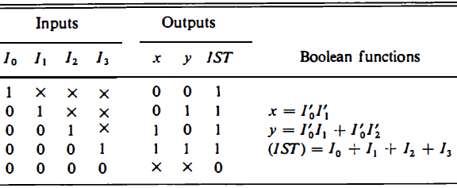
Priority Encoder
It is a circuit that implements the priority function
If two or more inputs arrive at the same time, the input having the highest priority will take precedence
Truth table of a Four-input Priority Encoder is given in below Table
  I₀ has the highest priority
  when I₀ = 1, the output generated is xy = 00
  I₁ has the next priority level, and so on….
IST = 1, only when one or more inputs are equal to 1
If all inputs are 0, IST = 0
  and VAD is NOT transferred to the CPU
TABLE: Priority Encoder Truth Table

Slide 33

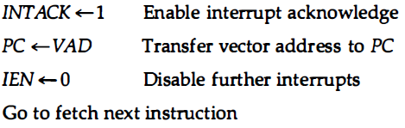
Interrupt Cycle
At the end of each instruction cycle the CPU checks IEN and IST
  If IEN=0 & IST=0, control continues with the next instruction
  If IEN=1 & IST=1, the CPU goes to an INTERRUPT CYCLE
During the interrupt cycle, the CPU performs the following sequence of micro-operations:

Slide 34
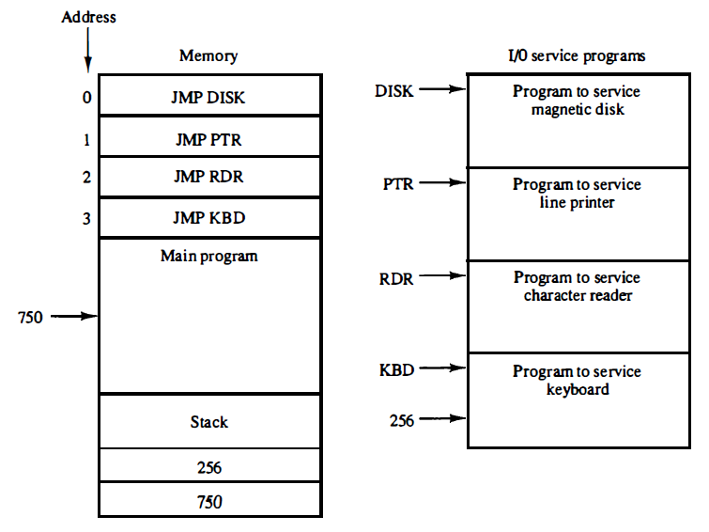
Software Routines
Figure shows the programs that must reside in memory for handling the interrupt system.
Each device has its OWN SERVICE PROGRAM that can be reached through a JUMP (JMP) instruction stored at the assigned VECTOR ADDRESS.
  Symbolic name of each routine represents the starting address of the service program.
  Stack is used for storing the return address after each interrupt
Programs stored in memory for servicing interrupts

Slide 35
Example:
CPU is executing the instruction in location 749.
KEYBOARD sets its interrupt bit.
Computer stores the return address 750 in the stack.
Accepts vector address (3) 00000011 and transfers it to PC.
Instruction in location 3 is executed.
Suppose,
DISK sets its interrupt bit when the CPU is executing the instruction at address 255 in the KBD program
Address 256 is pushed into the stack and control is transferred to the DISK service program
When the disk service program is completed, the return instruction POPS the stack and places 256 into PC
This returns the control to KBD routine to continue servicing the keyboard
At the end of KBD program, the last instruction pops the stack and returns control to the main program at address 750
Thus, a higher-priority device can interrupt a lower-priority device

Slide 36
Initial and Final Operations
The Initial Sequence of each interrupt service routine must have instructions to control the interrupt hardware in the following manner:
  1. Clear lower-level mask register bits
  2. Clear interrupt status bit IST
  3. Save contents of processor registers
  4. Set interrupt enable bit IEN
  5. Proceed with service routine
The Final Sequence in each interrupt service routine must have instructions to control the interrupt hardware in the following manner:
  1. Clear interrupt enable bit IEN
  2. Restore contents of processor registers
  3. Clear the bit in the interrupt register belonging to the source that has been serviced
  4. Set lower-level priority bits in the mask register
  5. Restore return address into PC and set IEN

Slide 37
Direct Memory Access
In DMA, the CPU is idle and the peripheral device manage the memory buses directly.
DMA controller takes over the buses to manage the transfer directly between the I/O device and memory.
The DMA transfer can be made in several ways.
  Burst Transfer - A block of memory words is transferred in a continuous burst at a time. Used for fast devices such as magnetic disks, where data transmission cannot be stopped or slowed down until an entire block is transferred.
  Cycle Stealing - Allows the DMA controller to transfer one data word at a time, after which it must return control of the buses to the CPU. The CPU merely delays its operation for one memory cycle to allow the direct memory I/O transfer to “steal” one memory cycle.

Slide 38
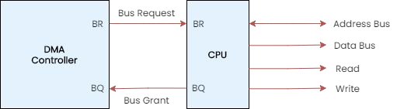
Working of DMA
Bus Request (BR) input - used by DMA controller to request the CPU to relinquish control of the buses.
When this input is active, CPU terminates the execution of the current instruction and places address bus, data bus, and RD/WR lines into high-impedance state(like an open circuit)
CPU then activates Bus Grant(BG) output to inform external DMA that the buses are available.
DMA takes control of the buses to conduct memory transfers without processor intervention.
When DMA terminates the transfer, it disables BR line and CPU disables BG line, takes control of the buses and returns to its normal operation.

Slide 39
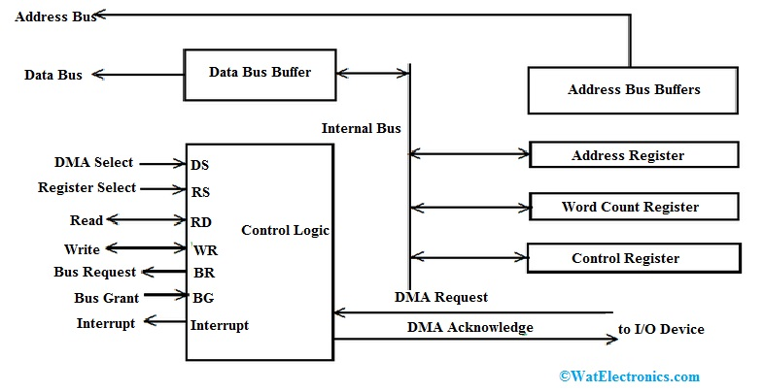
DMA Controller
Registers in DMA are selected by CPU through the address bus by enabling the DMA Select(DS) and Register Select(RS) inputs.
When BG = 0, CPU can communicate with DMA registers.
When BG = 1, DMA can communicate directly with memory.
DMA controller has three registers.
Address register: contains address to specify desired location in memory. It is incremented after each word transfer
Word Count Register: holds the no. of words to be transferred. It is decremented by 1 after each word transfer and checked internally for 0.
Control Register: specifies the mode of transfer i.e., read or write
DMA communicates with external peripheral through the request and acknowledge lines.

Slide 40
DMA Transfer
When I/O device sends a DMA request, DMA Controller activates the BR line.
CPU responds with BG line.
  DMA puts current value of its address register into address bus, initiates RD or WR signal, and sends a DMA acknowledge to I/O device.
I/O device puts a word in the data bus (for write) or receives a word from the data bus (read).
  The peripheral unit can then communicate with memory through data bus for direct transfer between the two units while the CPU is momentarily disabled.
For each word that is transferred, DMA increments its address register and decrements its word count register.
If word count does not reach zero, DMA checks the request line coming from the I/O Device.
If there is no request, DMA disables BR so that the CPU continues to execute its own program.
When peripheral requests another transfer, DMA requests bus again.
If the word count register reaches zero, DMA stops any further transfer and removes its bus request. It also informs the CPU of the termination by an interrupt.

Slide 41
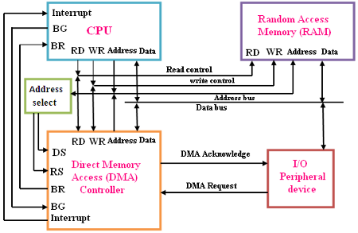
DMA Transfer

Slide 42
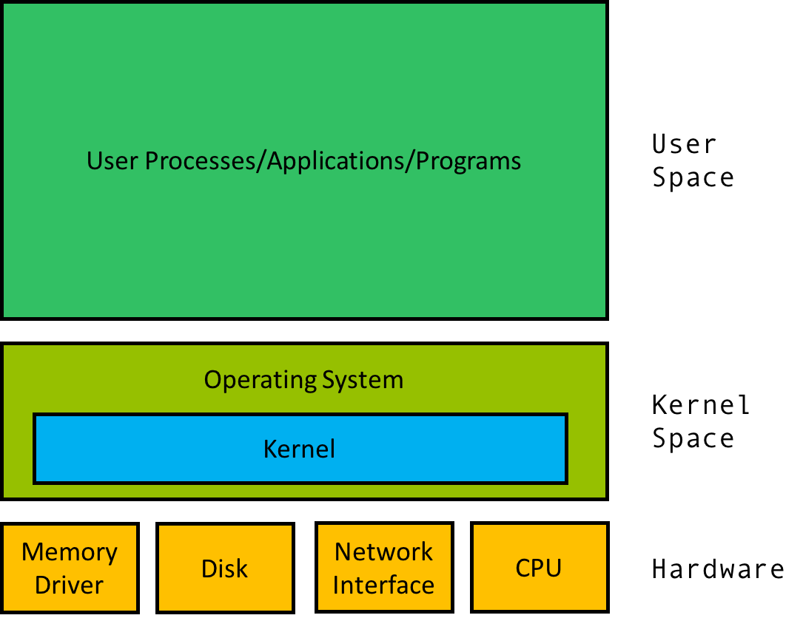
Types of Instructions
To ensure proper functioning of OS, we must be able to distinguish between the execution of the user application code and the OS code.
  User mode (non-privileged mode) and
  Kernel mode (supervisor mode/system mode/privileged mode).
Instructions in the operating system are divided into two categories:
  Non-privileged instructions: These are normal instructions.
  Privileged instructions: These instructions must be used wisely as their misuse can harm the system.
A non-privileged instruction is an instruction that any application or user can execute.
A privileged instruction, on the other hand, is an instruction that can only be executed in kernel mode.

Slide 43
Privileged & Non-Privileged Instructions
Privileged instructions: instructions executed in kernel mode.
  If a privileged instruction is executed in user mode, it is ignored and treated as illegal instruction. It is trapped in OS by the hardware.
  OS must ensure that the Timer is set to interrupt before transferring control to any user application. As a result, OS can regain control if the timer is interrupted.
  OS uses privileged instruction to ensure proper operation.
Examples
  I/O instructions
  Context switching
  Clear memory
  Set the timer of the CPU
  Halt instructions
  Interrupt management
  Modify entries in the Device-status table
Non-Privileged instructions are the instructions that are only executed in user mode.
Examples
  Generate trap instruction
  Reading system time
  Reading status of processor
  Sending the output to the printer
  Performing arithmetic operations

Slide 44
Software Interrupts and Exceptions
Exceptions and interrupts are unexpected events that disrupt the normal flow of instruction execution.
An exception is an unexpected event from within the processor.
An interrupt is an unexpected event from outside the processor
  External interrupts come from I/O devices or from any other external source.
    Ex: I/O device requesting transfer of data, I/O device finished transfer of data, elapsed time of an event, or power failure.
  Internal interrupts also called traps arise from illegal or erroneous use of an instruction or data.
  Ex: register overflow, attempt to divide by zero, an invalid operation code, stack overflow, and protection violation.

Slide 45
Programs and Processes - Role of interrupts in process state transitions
A program loaded into the memory becomes the process which performs all the tasks mentioned in the program.
A process is an instance of a computer program that is being executed. When a process executes , it passes through different states.
Context switching helps to share a single CPU across all processes to complete its execution and store the system's tasks status.
  It is a technique used by OS to switch a process from one state to another to execute its function using CPU.
  During switching, it stores the old running process's status in registers and assigns the CPU to a new process to execute its tasks.
  While a new process is running in the system, the previous process must wait in a queue.
  The execution of the old process starts at that point where another process stopped it.

Slide 46
Context Switch
Whenever an interrupt arrives, the CPU must do a state-save of the currently running process, then switch into kernel mode to handle the interrupt, and then do a state-restore of the interrupted process.
Similarly, a context switch occurs when the time slice for one process has expired and a new process is to be loaded from the ready queue. This will be instigated by a timer interrupt, which will then cause the current process's state to be saved and the new process's state to be restored.
Saving and restoring states involves saving and restoring all of the registers and program counter(s), etc.
Context switching happens frequently, and the overhead of doing the switching is just lost CPU time, so context switches ( state saves & restores) need to be as fast as possible. Some hardware has special provisions for speeding this up, such as a single machine instruction for saving or restoring all registers at once.

